Slide 1

HOMELESSNESS & THE WEINGART RESPONSE

Slide 2
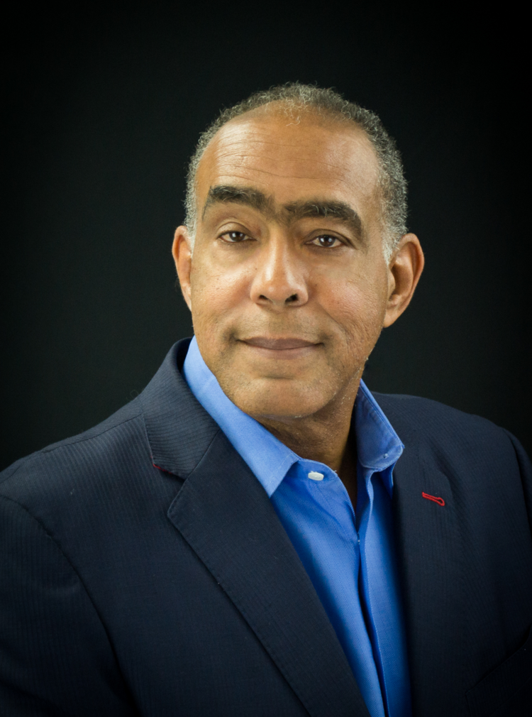
Homelessness and the Weingart Response
CURRENT
President and CEO, Weingart Center Association since 2011.
PRIOR
12 years in California State Legislature
Managing partner, William Morris Agency, 1982
BOARDS
Federal Home Loan Bank of San Francisco
California American Water
Hawaii American Water
Central City Association
MEMBER
California State Bar
L.A. World Affairs Council
Pacific Council on International Relations
EDUCATION
JD, Loyola Law School
MBA, Loyola Marymount University
BS, California State University, Northridge
Studied in Kennedy School of Government at Harvard University
SENATOR KEVIN MURRY (ret.)
President & Chief Executive Officer

Slide 3

Homelessness and the Weingart Response
CURRENT
Chief Operating Officer, Weingart Center Association since 2016.
PRIOR
Chief Operating Officer, Skid Row Housing Trust
Mercy Housing California
  Regional Director of Philanthropy
  Director of Strategic Initiatives
  Vice President Resident Services
Program Liaison, Mayor Riordan’s Office
Program Director, Weingart Urban Center YMCA
Senior Development Associate, Netzel Associates
RECOGNITION
Recognized as one of L.A.’s 50 Power Women in Real Estate Development
Recipient of 2020 Impact-Makers to Watch Award
EDUCATION
Pepperdine University
Pacific Oaks, Pasadena
Fashion Institute Design & Merchandising, L.A.
TONJA BOYKIN
Chief Operating Officer

Slide 4
Homelessness and the Weingart Response
EMPOWERING & TRANSFORMING LIVES
The Weingart Center is a 501(c)(3) nonprofit agency that provides homeless individuals with the basic tools necessary to stabilize their lives, secure income, and find permanent housing.
Its mission is to empower and transform lives by delivering innovative solutions to break the cycle of homelessness.
The Weingart Center provides direct services to more than 44,000 economically disadvantaged individuals per year.
The Weingart Center offers programs that are uniquely tailored to meet the diverse needs of the populations it serves.
  The Weingart Center’s primary programs and services are housed in the 11-story former El Rey Hotel building, originally designed by architect Charles Wittlesey in 1925, and is located at the corner of 6th Street and San Pedro Street in Downtown Los Angeles.
  In 1951, Ben and Stella Weingart started the Weingart Foundation.
  1983, the El Ray Hotel was donated to the Weingart Center.

Slide 5
Homelessness and the Weingart Response
THE STATE OF HOMELESSNESS IN THE U.S., 2021
The number of individuals experiencing homelessness in the U.S. is estimated at 552,830.
Every year, roughly 13,000 people experiencing homelessness die in the U.S.
Statistics on homeless demographics reveal that age disparities are a common occurrence on the street.
Only 15.6% are aged 51-61
Only 3.2% are aged 62 or older
20% are children

Slide 6

Homelessness and the Weingart Response
THE STATE OF HOMELESSNESS IN THE U.S., 2021 (con’t)
Only 48% are White
39% are Black/African American
13% are of Hispanic origin
Native Americans make up 2.8%
61% are male
40% of all men experiencing homelessness are Veterans
8% of homeless veterans are women

Slide 7
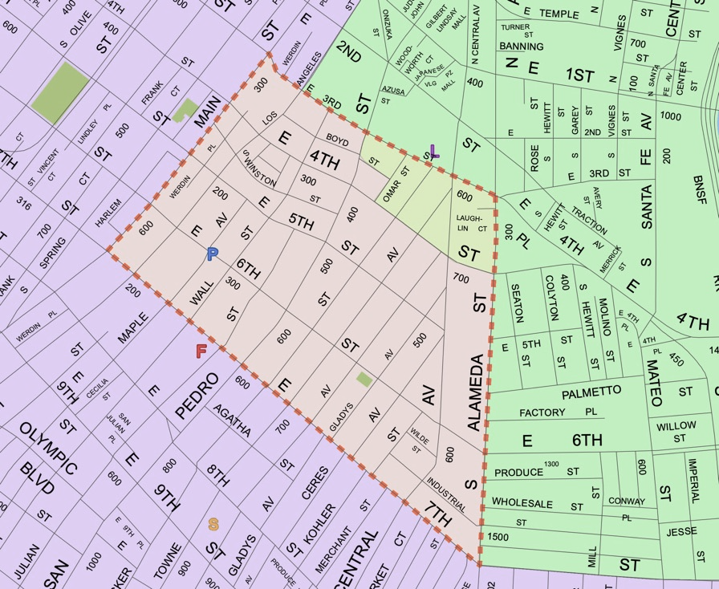
Homelessness and the Weingart Response
SKID ROW: AN EARLY HISTORY
The term “Skid Row” originated during the construction of the mid-19th Century Railroads
The railroad workers were mostly transient, immigrant men
Alcoholism grew among this population of men
Religious organizations responded by opening shelters
During the 1930s Great Depression, men from all over headed West for employment
This pattern of transient population continued into the 1950s and 1960s
The 1970s brought Vietnam Veterans to Skid Row.
Legislation was passed to deinstitutionalize hospitals serving the mentally ill
In the 1950s, many of the residential hotels fell into disrepair
In the 1970s, L.A. Mayor, Tom Bradley created a special Blue Ribbon Commission
The 1980s saw a substantial increase in homelessness
SKID ROW BOUNDARIES
East: 3rd St.
North: Main St.
West: 7th St.
South: Alameda St.

Slide 8
1980s
1980s
President Reagan repeals the Mental Health Systems Act.
DMH notes a rise in mental health cases: 50% overall, 90% in women.
Economic downturn, rising housing prices, and lack of affordable housing.
Committee formed to address the inebriated.
WCA opens its doors in 1983 in the El Rey Hotel in DTLA. It included:
  • 24-hour clinic
  • Mental health center
  • Detox center

Slide 9
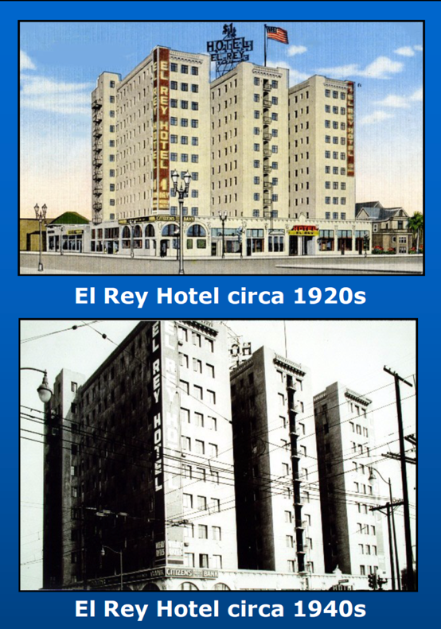
1980s
The Weingart Center’s primary programs are housed in the 11-story former El Rey Hotel building, located at the corner of 6th and San Pedro Street.
The building was constructed in 1926, which later came under the ownership of Ben Weingart and the Weingart Foundation.
In 1983, the Weingart Center was opened as a “one-stop” service facility to address the homelessness crisis in Los Angeles.
Located in a single building, the Weingart Rehabilitation Center was the first all-inclusive facility for alcoholism recovery and related services in the country.
The facility accommodated both men and women.

Slide 10
1980s
ORIGINAL IN-HOUSE AGENCIES
Volunteers of America of Los Angeles - Alcoholism Services Division
Veterans Administration
Public Inebriate Program
Department of Public Health of Los Angeles
Department of Public Social Services of Los Angeles County
State of California Department of Rehabilitation

Slide 11
1980s
ORIGINAL IN-HOUSE SERVICES
24-hour Inebriate Reception Center
Detoxification Unit, 51 beds (15 for women)
County Medical Health Services Center
Short-term Crisis Housing
Department of Public Social Services Outstation for Public Assistance
Meals and related Nutrition Services
Clothing
Rehabilitation Care
Social Center for non-inebriate indigents
Drug Abuse Clinic

Slide 12
1980s
ORIGINAL CAMPAIGN COMMITTEE
HONORABLE TOM BRADLEY
Mayor of Los Angeles
ROBERT F. ERBURU
Times Mirror Company
ROBERT D. FLETCHER
Avery International
IVAN J. HOUSTON
Golden State Mutual Life Insurance
TOM JOHNSON
Times Mirror Company
JOHN KERN
Presidential Life Insurance Company
ROBERT F. MAGUIRE
Maguire, Thomas Partners
DR. FRANKLIN D. MURPHY
Times Mirror Company
SIDNEY R. PETERSEN
Getty Oil Company
LOUIS A. ROWAN
R. A. Rowan Company
KYHL SMEBY
Bank of America
CHRISTOPHER L. STEWART
Central City Association
HARRY J. VOLK
Weingart Foundation
PHILLIP WILLIAMS
Times Mirror Company
TIMOTHY B. FLYNN, ESQ.
Public Justice Foundation
JAMES L. GLASS
Campaign Executive Director
AL GREENSTEIN
Atlantic Richfield Company
JOHN N. HALEY
Mary Lind Foundation
WILLIAM M. MARC MARCUSSEN
Atlantic Richfield Company
STEPHEN C. MEIER
Times Mirror Company
HONORABLE BILLY MILLIS
Judge of the California Superior Court Chairman, Volunteers of America of Los Angeles
COL. PAUL H. NOLTE
Volunteers of America of Los Angeles
PAT PENNY
Pat Penny Public Relations
(Weingart Campaign PR/Weingart Foundation PR)
PHYLLIS QUAN
Atlantic Richfield Foundation
EUGENE M. WILSON
Atlantic Richfield Foundation
GEN. RAY C. TREMONT
Volunteers of America (National)

Slide 13
1990s
1990s
Major job loss across the nation. Unemployment up by 11%.
New apartment construction crash.
$1.3 Billion annual shortfall for L.A. County, 1995-1996.
WCA begins Job Training & Workforce Development.
WCA’s first medical clinic opens with JWCH.
WCA identifies a women-only floor with tailored programs.

Slide 14





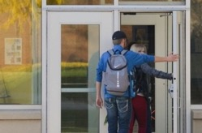
1990s
SERVICES OFFERED IN THE 1990s
WCA partnered and collaborated with multiple public and private agencies to provide:
Emergency Services • Short-term Housing • Community Re-entry for Parolees and Probationers
General Relief Opportunity for Work (GROW) • Workforce Development • Education
WCA also started a Clinical Services Department, which continues to conduct individual and group sessions to address:
Medical and mental health
Substance abuse
Other personal issues preventing participants from leading productive lives off the streets
In the 1990s the Weingart Center began developing targeted programs for Veterans, women, and the formerly incarcerated.
WCA also initiated a Recuperative Care program, which continues to provide shelter and support to medically stable individuals who are released from area hospitals with illnesses or injuries who only become worse due to homelessness.
In 1997, WCA opened a Walk-In Access Center, which continues to assist homeless individuals and families, as well as those at-risk of homelessness, by providing:
Informational resources
Referral services
Case advocacy

Slide 15
2000s
2000s
Mental health cases increase by 60% in 2000.
Shelter beds jump from 8,000 to 13,000.
Unemployment up by 11%.
WCA creates a Mental Health & Clinical Case Management Department.
In 2014, WCA begins exploring Permanent Supportive Housing options.
In 2016, WCA begins its first Permanent Supportive Housing development, Tower 1A.

Slide 16
2000s
EXPANDED SERVICES IN THE 2000s
Throughout the 2000s, the Weingart Center expanded its services, serving 40,000+ per year.
ACCESS CENTER
Housing referrals, case advocacy, bus tokens for scheduled appointments, legal aid, mail services, and a wide range of other social services to homeless individuals, families, and people at risk of becoming homeless.
OPEN DOOR
90-day crisis housing program linking clients to mental, physical, and substance abuse programs as well as workforce development.
SHORT-TERM HOUSING PROGRAM
This DPSS Voucher program is for Individuals applying for General Relief and is operated through contractual partnership with the L.A. Department of Social Services.
Working in collaboration with Coordinated Entry System, our Women’s Crisis Housing program helps homeless women with housing and supportive services.
HEALTH & MENTAL CARE SERVICES
Together with JWCH Institute and the L.A. Dept. of Health Services, these services offer an array of health and mental care, including medical, dental, optometry, individual and group therapy, trauma and substance abuse counseling, and recuperative care for homeless individuals who have been recently discharged from the hospital.
EDUCATION & JOB PREPAREDNESS
This program offers remedial education, literacy training, one-on-one tutoring, vocational education, job preparedness, and help with employment searches.

Slide 17
2000s
EXPANDED SERVICES IN THE 2000s (con’t)
Throughout the 2000s, the Weingart Center expanded its services, serving 40,000+ per year.
CASE MANAGEMENT
The Weingart Center offers one-on-one short-term and long-term case management services with a focus on goal-setting and attainment and are available for current and former clients.
SUBSTANCE ABUSE TREATMENT & HIV/AIDS SERVICES
Operated in partnership with the JWCH Institute, this program offers substance abuse treatment and HIV/ AIDS services to high-risk individuals living in Skid Row.
CAFÉ & BOUTIQUE
The Weingart Café provides three healthy meals a day to all Weingart Center clients. The Weingart Boutique provides personal care products and clothing, including professional attire for job interviews and employment searches.
RE-ENTRY PROGRAMS
THP is designed to provide housing, meals, support, programming, and supervision for serious and long-term offenders.
AB 109 is a 90-day re-entry program and requires a referral from the L.A. County Probation Department and provides transitional housing and employment assistance to those on Post-Release Community Supervision.
STOP (Specialized Treatment for Optimized Programming), which requires a parole officer referral, is a comprehensive re-entry program for parolees that provides housing, vocational training, education, and job placement services.

Slide 18
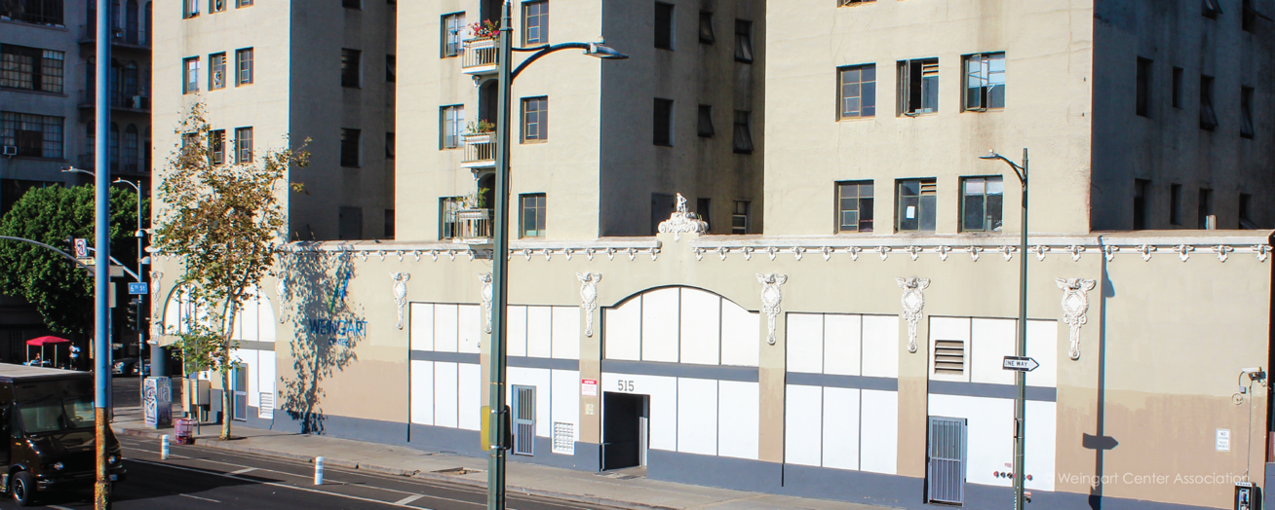
Present
STRATEGIC PLAN
In 2018, Weingart Center Association laid out its Strategic Plan, articulating major goals designed to address homelessness.
Establish Permanent Supportive Housing Facilities
Expand Programs and Services to Meet the Evolving Needs of Our Clients
Identify Initiatives to Grow Core Programs

Slide 19
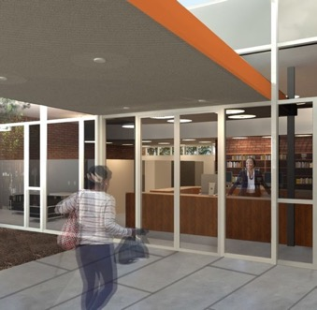
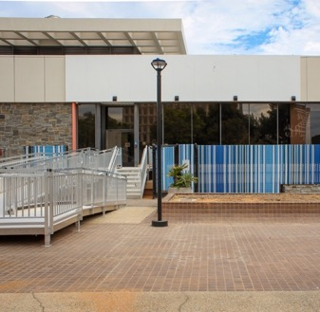
Present
Increase Interim Services to the Greater Los Angeles Area
GARDNER STREET
WOMEN’S BRIDGE HOUSING
1403 N Gardner St
Los Angeles, CA 90046
Previously a shuttered city-owned library, the Gardner Street Women's Bridge Housing provides programs and services for thirty women experiencing homelessness. The center includes a kitchen, garden, terrace, dining area, and a female staff, including Licensed Clinical Social Workers, to provide wrap-around services around health, well-being, and life skills.
A BRIDGE HOME –
CIVIC CENTER
310 N Main St
Los Angeles, CA 90012
The ABH Civic Center is a 99-bed, service-enriched program for men and women designed to quickly bring homeless Angelenos off the street, stabilize their lives, and move on to permanent housing. Services include housing placement, case management, mental health services, substance abuse support, personal storage, and a place for clients’ pets.

Slide 20
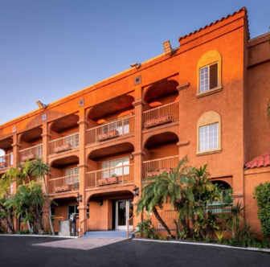
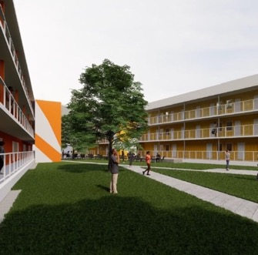
Present
Increase Interim Services to the Greater Los Angeles Area (con’t)
THE
BEACON
1710 7th St
Los Angeles, CA 90017
The Beacon is a service-enriched interim housing program that converts to Permanent Supportive Housing around 2024. Services include case management, housing placement, mental health services, substance abuse support, personal storage, and is pet-friendly.
THE HILDA L. SOLIS
CARE FIRST VILLAGE
1060 N Vignes St
Los Angeles, CA 90012
Operated by the Weingart Center, the Hilda L. Solis Care First Village is a 60,000 square-foot build using prefabricated modular units to create 232 interim housing units. Services include housing placement, three meals a day, case management, mental health services, and substance abuse support, and is pet-friendly.

Slide 21
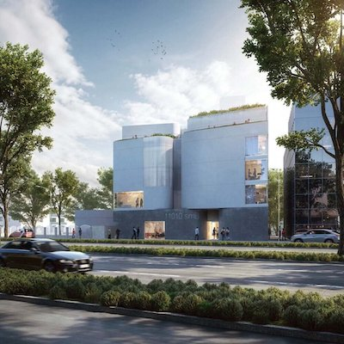
Present
Increase Permanent Supportive Housing Stock
11010 SMB
11010 Santa Monica Blvd. Los Angeles, CA 90025
Project Summary
51 unit, 5-story development: 50 studio units + 1 two-bedroom management unit.
Target Population
Seniors and Senior Veterans experiencing homelessness.
Status
Opening June 2022.
To learn more about the developments you see here, visit weingart.org/building-the-future.

Slide 22
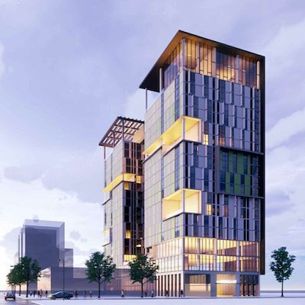
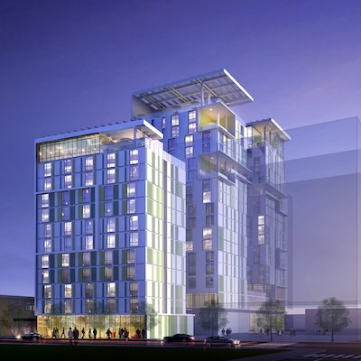
Present
Increase Permanent Supportive Housing Stock (con’t)
WEINGART TOWER 1A
555-561 S. Crocker St.
Los Angeles, CA 90013
Project Summary
278 unit, 19-story high-rise: 228 studio units + 47 one-bedroom units + 3 one-bedroom management units
Target Population
People experiencing homelessness.
Status
Construction to start early 2021
WEINGART TOWER 1B
554-562 S. San Pedro St. Los Angeles, CA 90013
Project Summary
104 unit, 12-story high-rise: 103 studio units + 1 one-bedroom management unit.
Target Population
People experiencing homelessness.
Status
Tentative 2021 construction.
To learn more about the developments you see here, visit weingart.org/building-the-future.

Slide 23
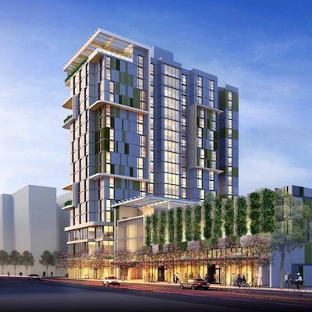
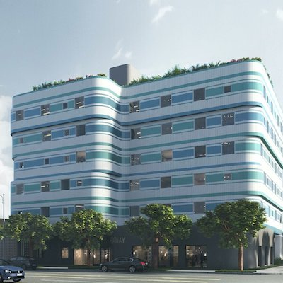
Present
Increase Permanent Supportive Housing Stock (con’t)
600 SAN PEDRO
600 S. San Pedro St.
Los Angeles, CA 90021
Project Summary
302 unit, 18-story high-rise: 298 studio units + 4 two-bedroom management units.
Target Population
People experiencing homelessness.
Status
Land use entitlements obtained
7024 BROADWAY
7024 S. Broadway
Los Angeles, CA 90003
Project Summary
52 unit, 6-story development: 40 studio units + 11 two-bedroom units + 1 two-bedroom management unit.
Target Population
Individuals and families experiencing homelessness.
Status
Predevelopment
To learn more about the developments you see here, visit weingart.org/building-the-future.

Slide 24

QUESTIONS?

Slide 25


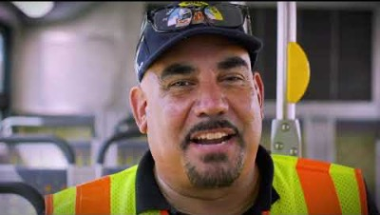
Success Stories
THE STORIES.
THE IMPACT.
These videos are testaments to the importance of investing in people within our city by giving opportunities for success to those in need.
To view additional Success Stories,
visit weingart.org/success-stories.

Slide 26
© 2021 Weingart Center Association; All Rights Reserved
To download a copy of this presentation, please visit weingart.org/timeline.

